Slide 1
Predictive Modeling for Toyota Corolla Car Prices
By Swency K

Slide 2
Objective
Primary Goal:
Develop a robust predictive model for estimating Toyota Corolla car prices.
Secondary Goals:
Uncover key factors influencing car prices through Exploratory Data Analysis (EDA).
Provide actionable insights for business decision-making in the automotive market.
Business Context:
Enhance pricing strategy.
Improve inventory management.
Optimize marketing strategies based on predictive modeling.
Why it Matters:
Accurate price predictions enable better-informed decisions, contributing to increased profitability and competitiveness in the automotive industry.

Slide 3
Exploratory Data Analysis (EDA)
Objective of EDA:
Understand the Data:
Gain insights into the structure and nature of the dataset.
Identify Patterns:
Explore relationships and patterns within the data.
Inform Feature Selection:
Identify features that are likely to impact the target variable (Car Prices).

Slide 4
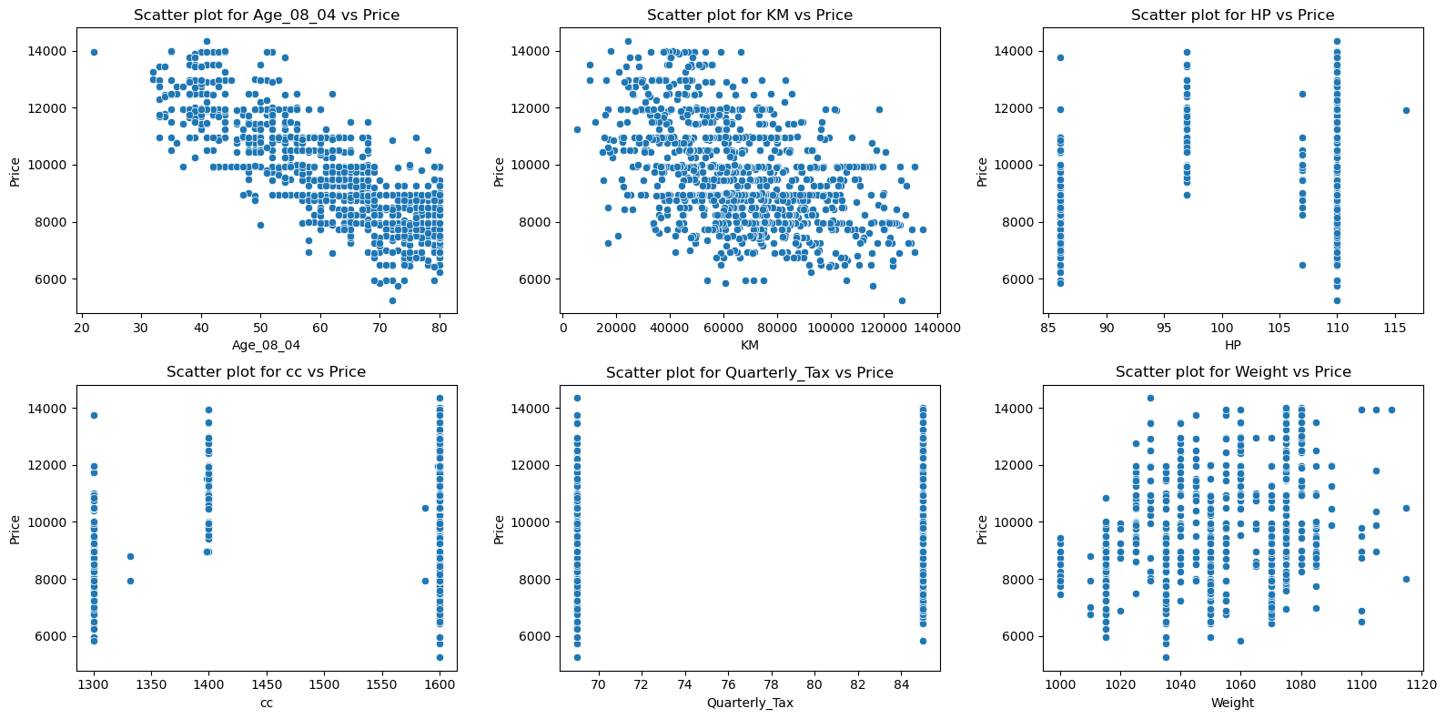
Scatter-plot
The scatter plots provide visual confirmation of the relationships between the selected features and the target variable (Price).
These insights are crucial for understanding how each feature contributes to the pricing dynamics of the Toyota Corolla dataset.

Slide 5
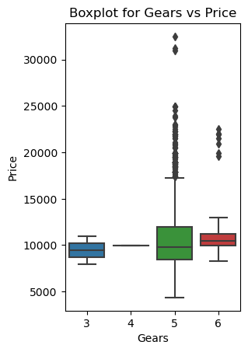
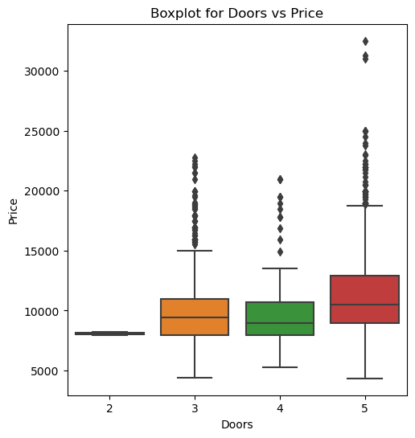
Box-Plot
The number of doors seems to be a factor influencing the price of cars, with 4-door cars generally having a higher median price
The number of gears might have some impact on the price,
but other factors could also contribute to the variation in car prices within each gear category.

Slide 6
Model Building
Key Components:
Data Splitting:
Split the dataset into training and testing sets.
X (Features): Age, KM, HP, cc, Doors, Gears, Quarterly_Tax, Weight
y (Target): Price
Linear Regression:
Selected a linear regression model for its simplicity and interpretability.
Assumptions: Linearity, Independence, Homoscedasticity, Normality of residuals.
Model Training:
Trained the linear regression model on the training data.
Utilized the selected features to learn the relationships with the target variable (Price).
Predictions:
Generated predictions on the test set using the trained model.
Obtained predicted prices for evaluation.
Evaluation Metrics:
Calculated Root Mean Squared Error (RMSE): [Value]
Measures the average magnitude of prediction errors.
Computed R2 Score: [Value]
Indicates the proportion of variance in car prices explained by the model.

Slide 7
Business Impact
Pricing Strategies Based on Model Insights:
By leveraging the identified features (such as age, mileage, horsepower, etc.), the business can tailor pricing to maximize revenue and competitiveness.
Optimizing Inventory and Marketing:
Marketing efforts can be tailored to emphasize features that contribute positively to car prices, potentially attracting customers looking for specific characteristics.
Customer Engagement and Expectation Management:
Communicating transparently about how certain features impact prices can enhance customer trust.
The model's insights can guide customer engagement strategies and help manage expectations regarding pricing.

Slide 8
Enhanced Decision-Making for Dealerships:
Dealerships can use the model's insights to make informed decisions about inventory selection, pricing adjustments, and marketing campaigns.
This enables more strategic and data-driven decision-making in the highly competitive automotive market.
Competitive Advantage:
The business gains a competitive advantage by leveraging predictive modeling to stay ahead of market trends.
Anticipating price trends and understanding customer preferences contribute to a more agile and competitive business approach.

Slide 9
Insight
Strong Predictive Power (R^2 Score: 0.82) - This suggests that approximately 82% of the variance in prices is captured by the model.
Positive Skewness in Price Distribution- This skewness aligns with real-world expectations, where most cars are priced affordably but some command premium prices.
Key Features Impacting Prices - Age, mileage (KM), horsepower (HP), engine capacity (cc), and weight show significant correlations with car prices.
Opportunity for Further Improvement- While the model is strong, there's always room for enhancement.

Slide 10
Continuous Improvement
Feature Engineering
Continuous Monitoring and Updating
Collaboration with Marketing Teams
Customer Engagement Strategies
Training and Knowledge Sharing

Slide 11
Conclusion
The developed predictive model not only serves as a valuable tool for estimating Toyota Corolla car prices but also offers a deeper understanding of the factors shaping the automotive market. This project lays the foundation for continued exploration and refinement, aligning with the dynamic nature of the automotive industry.

Slide 12
Closing Thought:
In essence, this project is not just about predicting car prices; it's a testament to the transformative potential embedded in data-driven decision-making.
It's about navigating the intricate landscape of variables, unveiling patterns, and using those revelations to navigate the road ahead.
As we close this chapter, we do so with a sense of accomplishment and a keen anticipation of the exciting journey that lies ahead in the realm of predictive modeling.
Thank you

